Slide 1
CONVERTER FOR SCIENTIFIC UNITS (Testing Using APPIUM)
R.Lahari sai
192011215
CSE

Slide 2
Project Includes
Introduction (Appium & Android Studio)
Objective
Applications used
Code Implementation
Appium Testing
Outcome

Slide 3
Abstract
Install Android Studio , IntelliJ and Appium Softwares.
Develop Unit Converter Application in Android Studio.
Open Unit Converter in Emulator.
Give Desired Capabilities in Appium Server.
Get the Java code for Testing.
Paste the code in IntelliJ IDE.
Run the code and Test the Conversions and Parameters.

Slide 4
Introduction
Appium
Open source Automation tool.
Automation Framework.
Automates different types of mobile applications testing.
It can test web , Native and Hybrid application.
It supports multiple programming languages.
(Java , python , ruby and many more )
6.It works on Emulator as well as Real Devices.

Slide 5
Introduction
Android Studio
It is Integrated development Environment.
It has fast Emulator for App Testing.
Used to Develop applications for Android devices.
It is an open source software.

Slide 6
Objective
To Develop Unit converter application using Android Studio and Run the application using Android Studio Emulator.
Installing The Appium Software and Testing the Unit Converter Application using the Appium Software.

Slide 7
Proposed Work
To Develop Scientific Unit converter Application.
Run the Application using Android Studio Emulator.
Test the Application in Appium Software.
Appium will Automate the Testing of Application.
Appium interacts with the Application and finds the positive and Negative Outcomes.
Different Strategies Will be tested using Appium.

Slide 8
Test Cases
App Launch
User Name
Temp Converter
Weight converter
Time Converter
String Input
Performance
Clear Input Button
Font Color , Size

Slide 9



Applications Used
APPIUM
INTELLIJ
ANDROID STUDIO

Slide 10
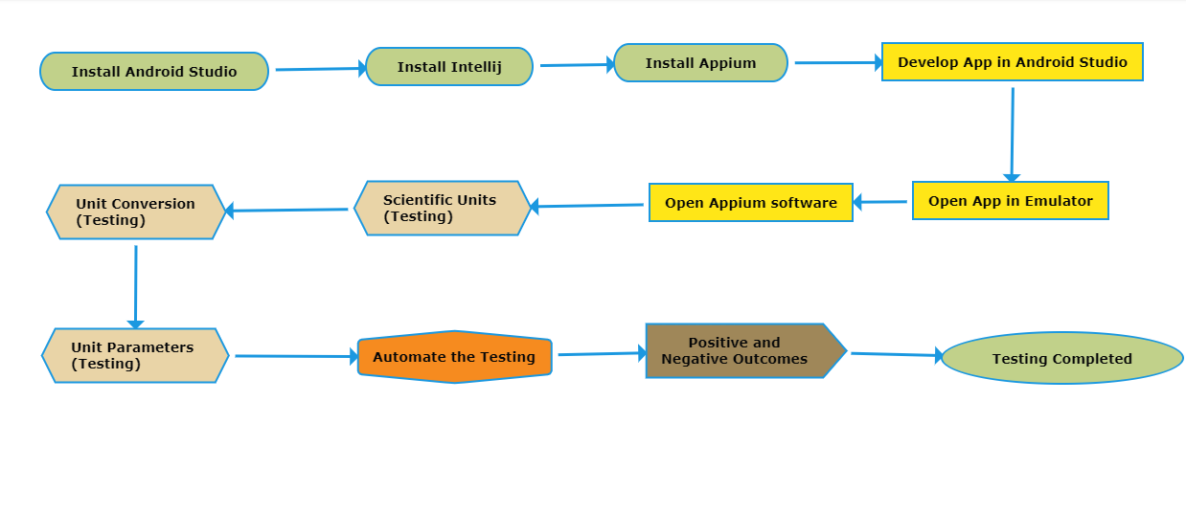
Data Flow Diagram

Slide 11
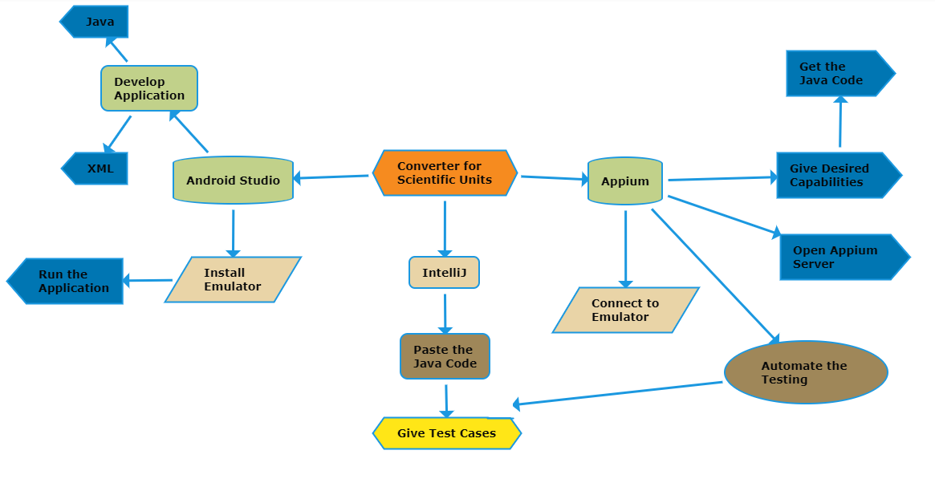
Concept Map

Slide 12
Test Case Outcomes
Username Visibility (Positive)
Temperature converter (Positive)
Weight Converter (Positive)
Time Converter (Positive)
String Input (Negative)
Performance (Positive)
Clear Input Button (Positive)
Font Color , Size change (Negative)
Parameters for all Converters (Positive)

Slide 13
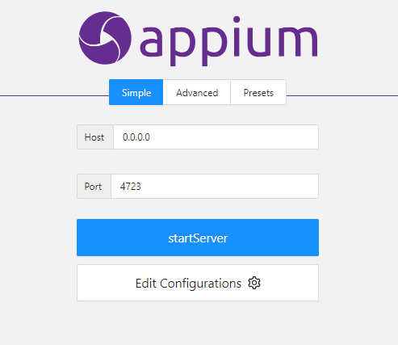
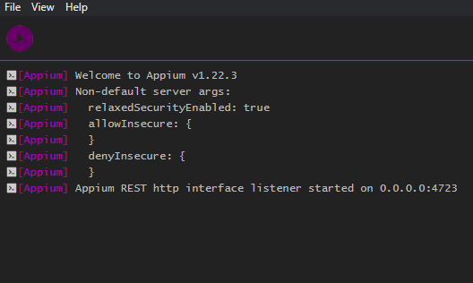
Appium Server
Before starting server
After starting Server

Slide 14
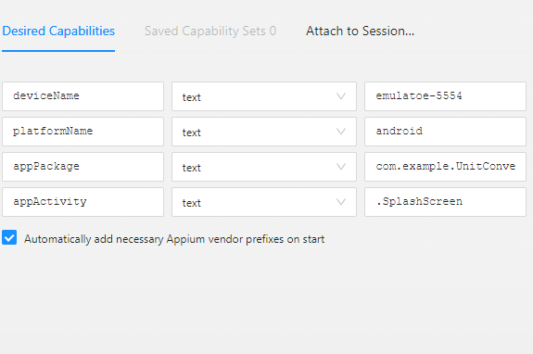
Appium Inspector (Desired Capabilities)
Give the Desired Capabilities in Appium Inspector.
It will start the session and gives you java code to start testing.
Paste the code in IntelliJ IDE and Start the Testing.

Slide 15
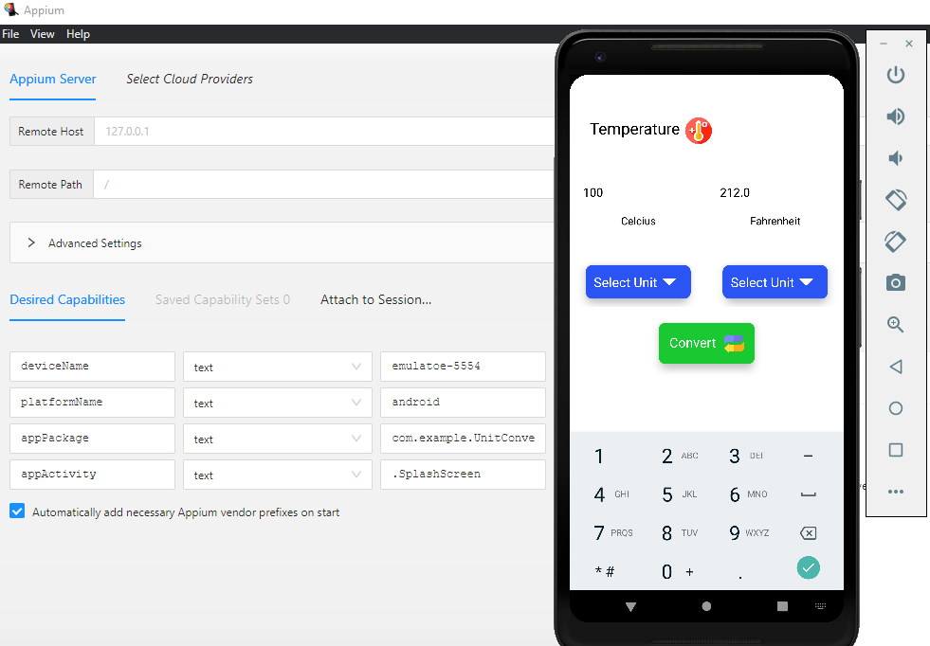
Testing OUTPUT

Slide 16
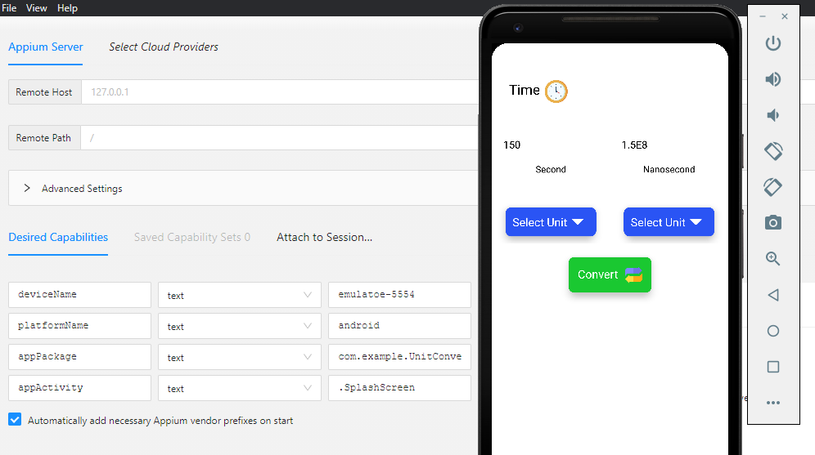
Testing OUTPUT

